Slide 1

Operation Analytics and Investigating Metric Spike

Slide 2

agenda:
Project Description
Approach
Tech-Stack used
Insights
Results
Conclusion

Slide 3
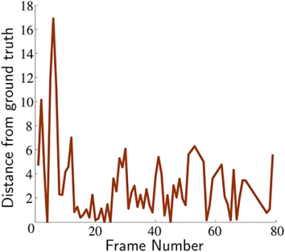
Project description:
Operation Analytics Project is a crucial process that involves analyzing a company's end-to-end operations. This analysis helps identify areas for improvement within the company. The overarching goal is to provide valuable insights for enhancing the company's end-to-end operations.
To handle this analysis Project effectively, as the Lead Data Analyst, it's crucial to start with a clear understanding of project objectives and departmental needs. Thoroughly explore and assess the provided datasets, collaboratively define metrics with departments, and develop advanced SQL queries for comprehensive analysis.

Slide 4
APPROACH:
Create the Database and Tables: Created a database for the project and necessary tables using the provided table structures and links.
Perform Analysis: Utilize SQL to perform the analysis and answered the questions mentioned in the case studies.

Slide 5



Tech-stack used:
For Extracting and Manipulating Data
Importing Database,
Running SQL queries to get Insights.
For Creating Project Report

Slide 6
Insights:
CASE STUDY 1:
Job Data Analysis

Slide 7
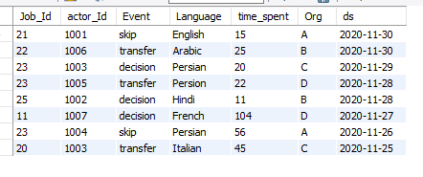
Table 1- job_data

Slide 8
1. Jobs Reviewed Over Time:
Objective: Calculate the number of jobs reviewed per hour for each day in November 2020.
Code:
SELECT ROUND(SUM(jobs_review_per_hour) / COUNT(ds), 3) AS jobs_review_per_hour_per_day
FROM
(
SELECT ROUND(COUNT(DISTINCT job_id) * 3600 / SUM(time_spent), 3) AS jobs_review_per_hour, ds
FROM job_data
WHERE MONTH(ds) = 11 AND YEAR(ds) = 2020
GROUP BY ds
) AS A;

Slide 9

Insights: Jobs reviewed per hour for each day in November 2020

Slide 10
2. Throughput Analysis:
Objective1: Calculate the 7-day rolling average of throughput (number of events per second).
Code:
WITH daily AS(
SELECT round(COUNT(event)/sum(time_spent),2) AS daily_throughput, ds AS date
FROM job_data
GROUP BY date
)
SELECT
ROUND(AVG(daily_throughput),2)
AS rolling_average,date
FROM daily
GROUP BY date;

Slide 11
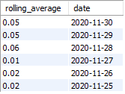
The 7-day rolling average of throughput:
Using a 7-day rolling average is preferred over a daily metric because it smoothes out short-term fluctuations, aligns with weekly reporting cycles, and highlights underlying trends.
It reduces the impact of outliers, improves decision-making, and strikes a balance between responsiveness and stability.

Slide 12

3.Language Share Analysis:
Objective: Calculate the percentage share of each language in the last 30 days.
Code:
SELECT language,
COUNT(job_id) AS Language_Count,
(COUNT(*) / (SELECT COUNT(*)
FROM Job_data)) * 100 AS Percentage_Share
FROM Job_data
GROUP BY language;

Slide 13
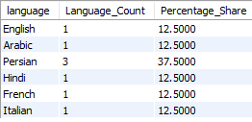
Result:
The percentage share of each language in the last 30 days.

Slide 14

4. Duplicate Rows Detection:
Objective: Identify duplicate rows in the data.
Code:
SELECT *
FROM job_data
GROUP BY job_id , actor_id , event , language , time_spent , org , ds
HAVING COUNT(*) > 1;
There were no duplicate rows in the table.

Slide 15

Insights:
CASE STUDY 2:
Investigating Metric Spike

Slide 16
1.Weekly User Engagement:
Objective: Measure the activeness of users on a weekly basis.
Code:
SELECT WEEK(occured_at) AS week_number, COUNT(DISTINCT user_id) AS weekly_engagement
FROM events
WHERE event_type='engagement’
GROUP BY week_number
ORDER BY week_number;

Slide 17
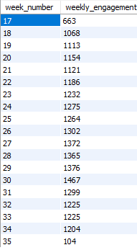
Result:

Slide 18
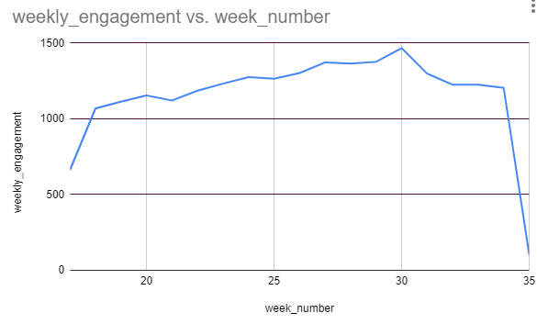
Variations in the number of active users on weekly basis.

Slide 19
2. User Growth Analysis:
Objective: Analyze the growth of users over time for a product.
Code:
SELECT DATE_FORMAT(created_at, '%Y-%m') AS month, COUNT(DISTINCT user_id) AS user_count,
LAG(COUNT(DISTINCT user_id)) OVER (ORDER BY DATE_FORMAT(created_at, '%Y-%m')) AS previous_user_count, (
COUNT(DISTINCT user_id) - LAG(COUNT(DISTINCT user_id)) OVER (ORDER BY DATE_FORMAT(created_at, '%Y-%m'))) / LAG(COUNT(DISTINCT user_id)) OVER (ORDER BY DATE_FORMAT(created_at, '%Y-%m')) * 100 AS growth_percentageFROM users
GROUP BY month
ORDER BY month;

Slide 20
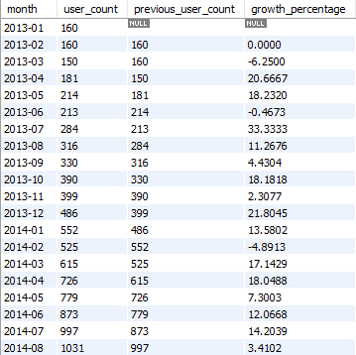
The growth of users over time for a product.

Slide 21
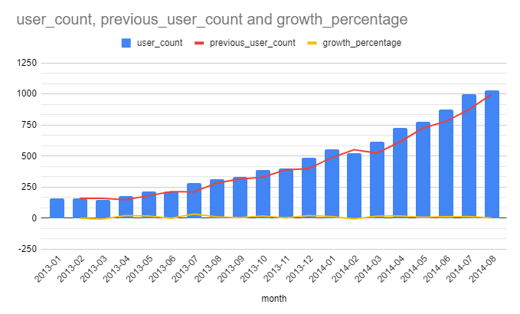
Column Chart showing USER GROWTH

Slide 22

3. Weekly Retention Analysis:
Objective: Analyze the retention of users on a weekly basis after signing up for a product.
Retention Rate, generally, refers to the percentage of
individuals or entities that continue to be engaged or remain
with a product, service, program, or organization over a
specific period.

Slide 23
Code:
WITH user_weekly_activity AS
(
SELECT user_id, WEEK(occured_at) AS week_number
FROM events
GROUP BY user_id, week_number
)
SELECT week_number AS current_week, LAG(week_number) OVER (ORDER BY week_number) AS previous_week,
COUNT(DISTINCT user_id) AS retained_users, LAG(COUNT(DISTINCT user_id)) OVER (ORDER BY week_number) AS starting_users,
COUNT(DISTINCT user_id) / LAG(COUNT(DISTINCT user_id)) OVER (ORDER BY week_number) * 100 AS retention_percentage
FROM user_weekly_activity
GROUP BY week_number
ORDER BY week_number;

Slide 24
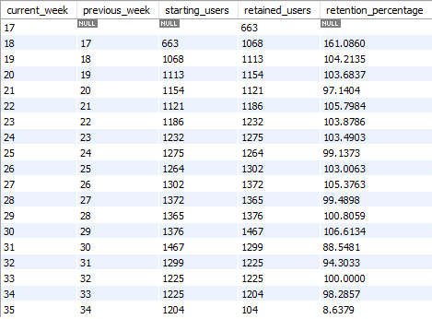
The retention of users on a weekly basis after signing up
for a product

Slide 25
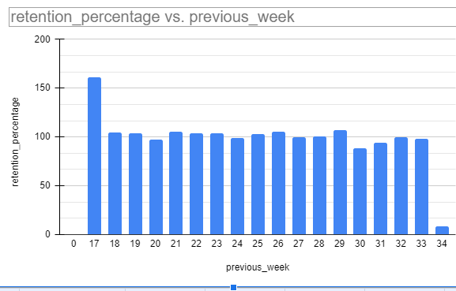
Week 17 has high retention percentage ,and
Week 34 has low retention percentage

Slide 26
4. Weekly Engagement Per Device:
Objective: Measure the activeness of users on a weekly basis per device.
Code:
SELECT WEEK(occured_at) AS week_number, device,
COUNT(DISTINCT user_id) AS weekly_engagement
FROM events
GROUP BY week_number, device
ORDER BY week_number, device;

Slide 27
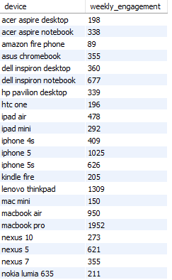
Result:
The activeness of users on a
weekly basis per device.

Slide 28
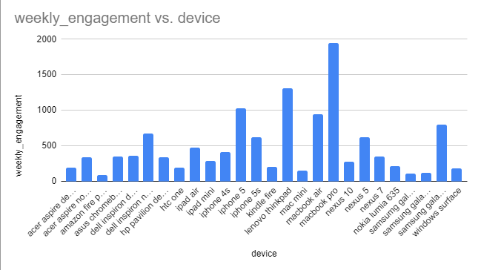
Macbook Pro device has high activeness of users
on a weekly basis.

Slide 29
5. Email Engagement Analysis:
Objective: Analyze how users are engaging with the email service.
Code:
SELECT user_id,
COUNT(DISTINCT user_id) AS total_emails_received,
COUNT( CASE
WHEN action='email_open'
THEN user_id END) AS total_emails_opened,
COUNT( CASE WHEN action='email_clickthrough'
THEN user_id END) AS total_emails_clicked,
COUNT( CASE WHEN action='sent_weekly_digest'
THEN user_id END) AS total_emails_delivered
FROM email_events
GROUP BY user_id
ORDER BY user_id;

Slide 30
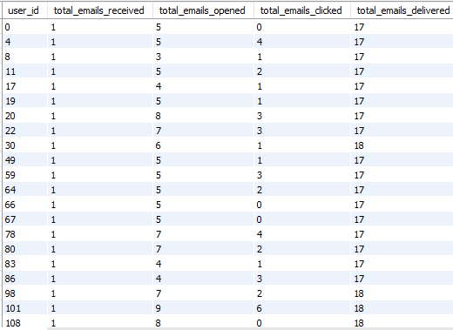
Users engaged with email service.

Slide 31
